Slide 1
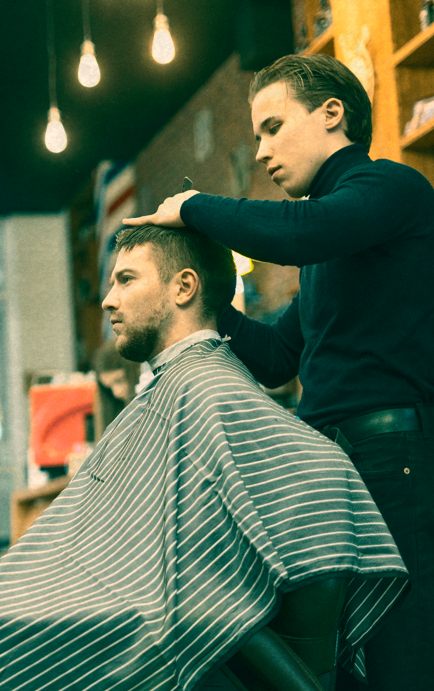
FIFO Barbershop
Problem
Mohammad Awais Dar 2020-CE-09
Usama Fiaz 2020-CE-11
Faiz E Alam Butt 2020-CE-17
Shahzaib Javed 2020-CE-25

Slide 2
Table of Content
01
02
03
04
05
06
Title
Introdcution
Problem Statement
Proposed Methodology
Applications in OS
Implementation (Code)
07
08
09
Demonstration
Lessons Learned
Conclusion

Slide 3

Introduction
Objective
Compare concurrent computing problems in operating systems to fairness in customer service.
Focus
Synchronization approaches and orderly resource allocation.

Slide 4
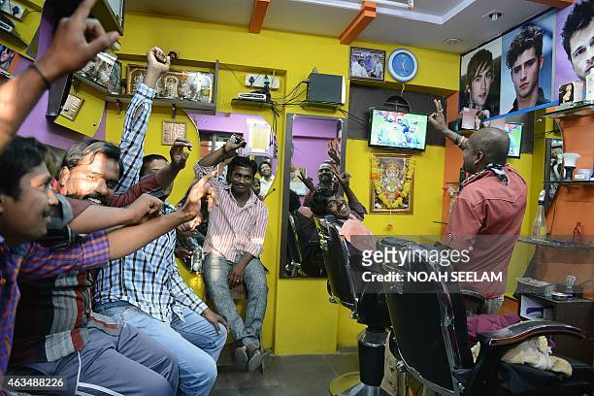

Slide 5


Slide 6

Problem Statement
Challenge
Similarity
To ensure that customers are served fairly, adhering to a FIFO policy. Fair execution means that customers who arrive first receive services first, avoiding any unfair advantage or discrimination in the service queue.
Venus has a beautiful name and is the second planet from the Sun. It’s terribly hot—even hotter than Mercury—and its atmosphere is extremely poisonous. It’s the second-brightest natural object in the night sky after the Moon

Slide 7
Problem Statement
Challenge
Similarity
To ensure that customers are served fairly, adhering to a FIFO policy. Fair execution means that customers who arrive first receive services first, avoiding any unfair advantage or discrimination in the service queue.
Venus has a beautiful name and is the second planet from the Sun. It’s terribly hot—even hotter than Mercury—and its atmosphere is extremely poisonous. It’s the second-brightest natural object in the night sky after the Moon

Slide 8
Proposed Methodology
Approach
Utilize semaphores and queues for synchronized resource access.
Semaphores
Manage chair availability, replicating OS resource distribution.
Queues
Service customers in arrival order, preventing race-related situations.

Slide 9
Applications in Operating Systems
Impact
Improve OS process coordination, guaranteeing equitable execution and conflict prevention.
Components
Semaphores and queues provide insights for enhancing multitasking settings, boosting system dependability, and efficiency.

Slide 10

Implementation (Code Overview)
Components
Key Elements
Global variables
Functions
initialize_barbershop
barber
Customer
main
1. Semaphores
2. Queues
3. Threading

Slide 11

Code Walkthrough
Slide Breakdown
Explain initialization, barber and customer functions, and the main simulation loop.
Focus on
Synchronization, chair management, and customer service order.

Slide 12
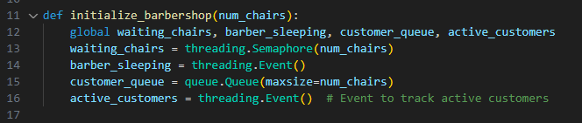
Initialize_barbarshop()

Slide 13
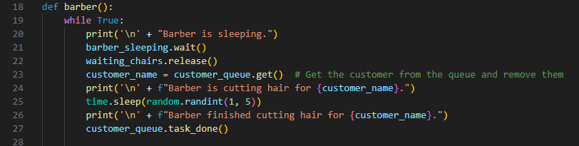
Barbar()

Slide 14
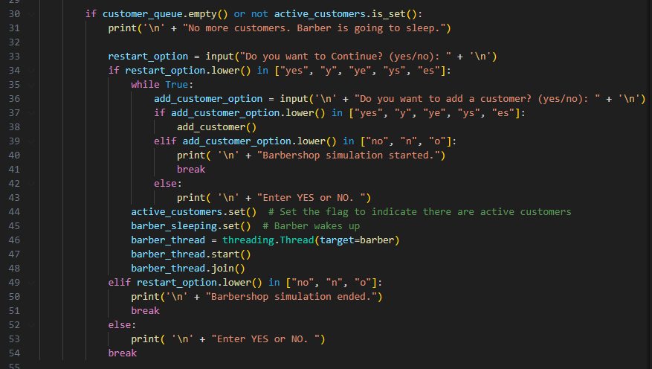

Slide 15
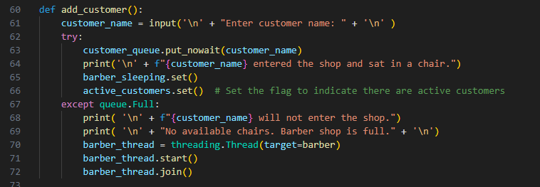
Add_customer()

Slide 16
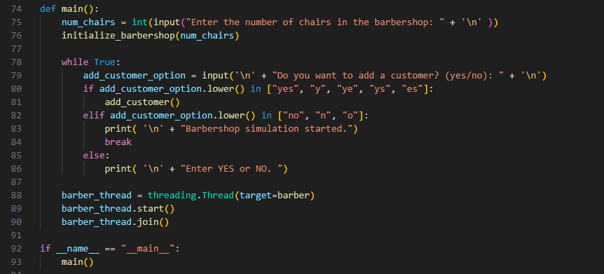
Main()

Slide 17
Lessons Learned
Insights Gained
The implementation of the FIFO Barbershop Simulation Project has provided valuable insights into the complexities of concurrent programming. Understanding how to manage multiple threads, allocate resources effectively, and synchronize interactions between processes has been a significant learning outcome. This knowledge is crucial for developing robust and efficient systems that can handle concurrent tasks.
Applicability
The acquired insights find direct applicability in real-world operating systems. The project's focus on semaphores, queues, and threading aligns with the challenges faced by operating systems in managing diverse processes concurrently. The lessons learned here contribute to a deeper understanding of practical solutions for enhancing system dependability, efficiency, and fairness in resource allocation.

Slide 18
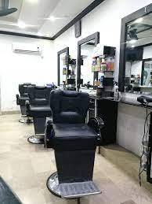
Conclusion
The project has been successfully implemented, showcasing a functional FIFO Barbershop Simulation. This simulation reflects the synchronization challenges inherent in managing customer interactions and resource allocation within a barbershop setting. The critical role of synchronized resource access in ensuring smooth process coordination. By employing semaphores, queues, and threading, the simulation highlights the significance of orderly resource allocation.

Slide 19
Thank You!

